Slide 1

Fixed-point iteration

Slide 2
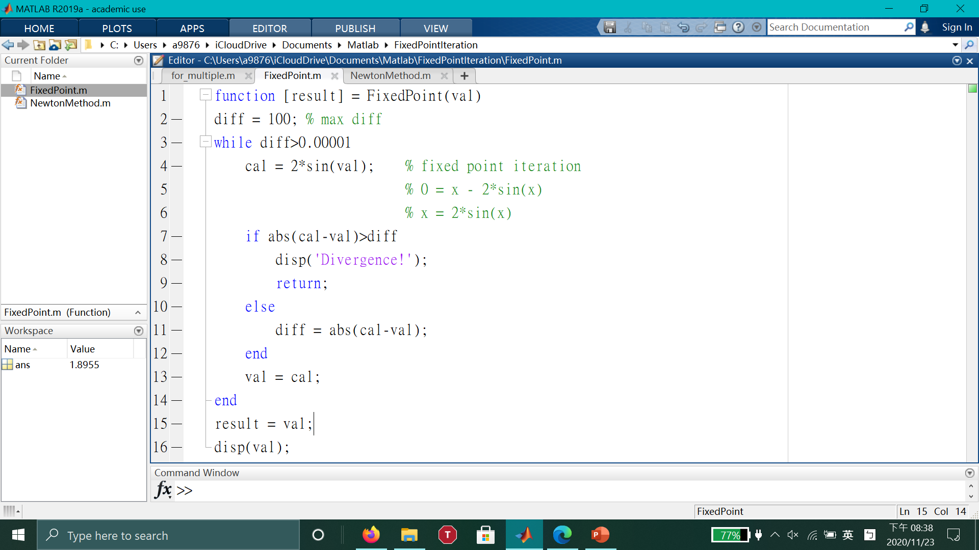

Slide 3
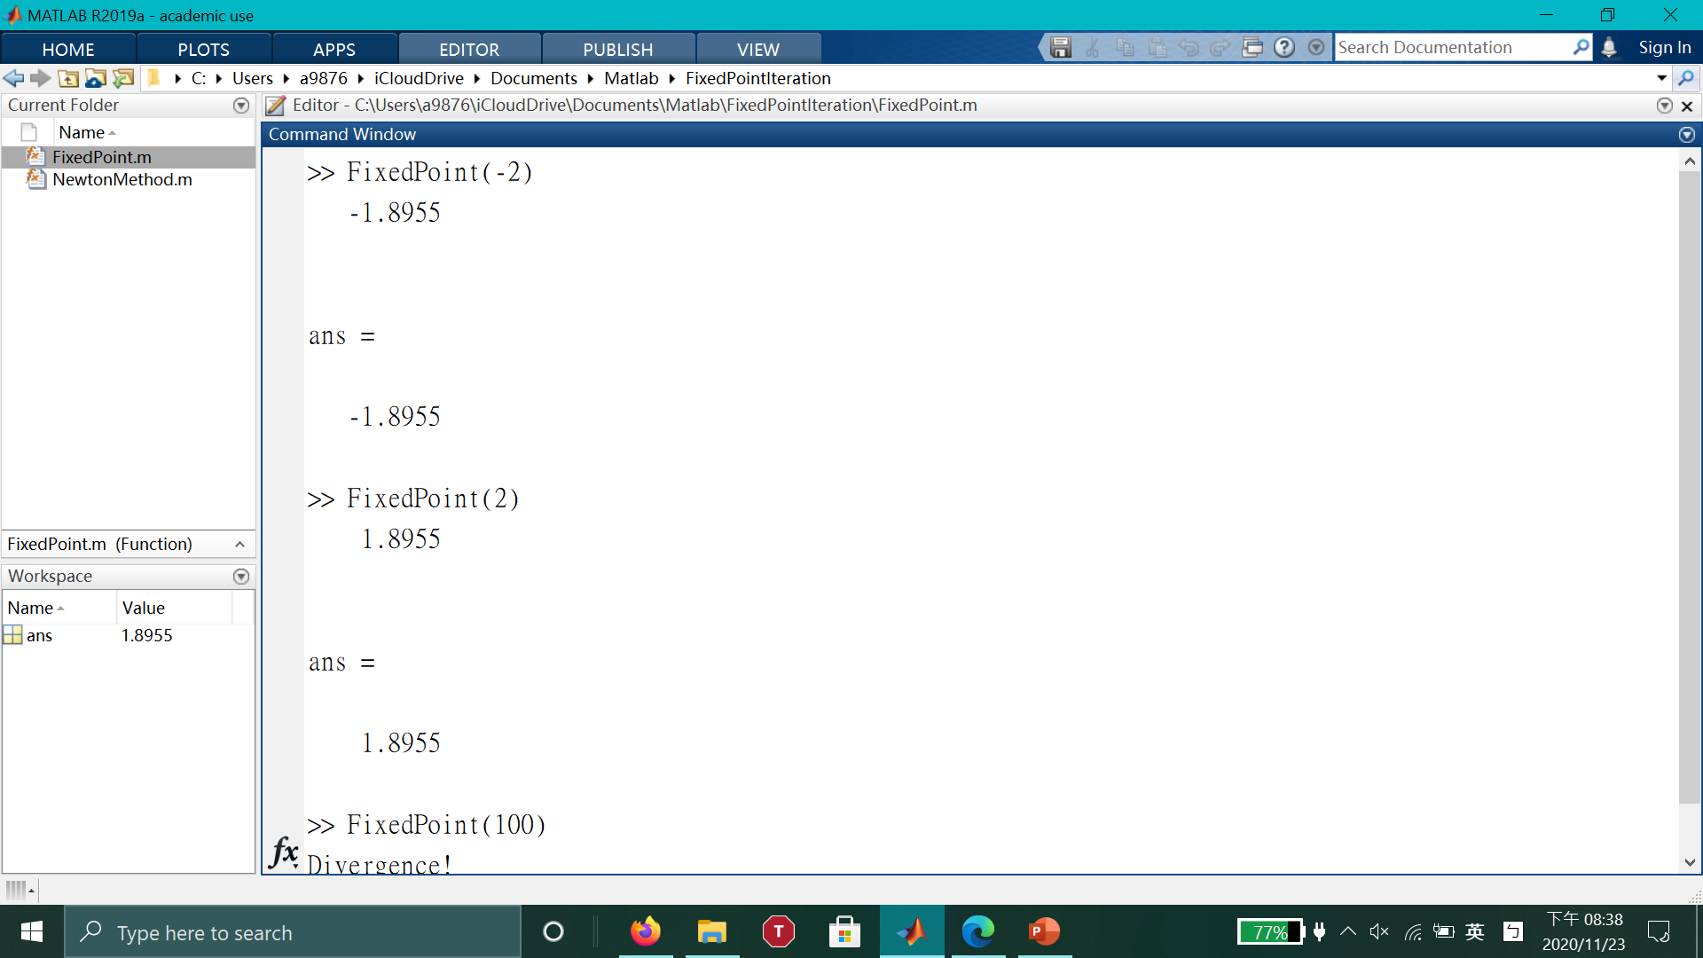

Slide 4

Newton’s method.

Slide 5
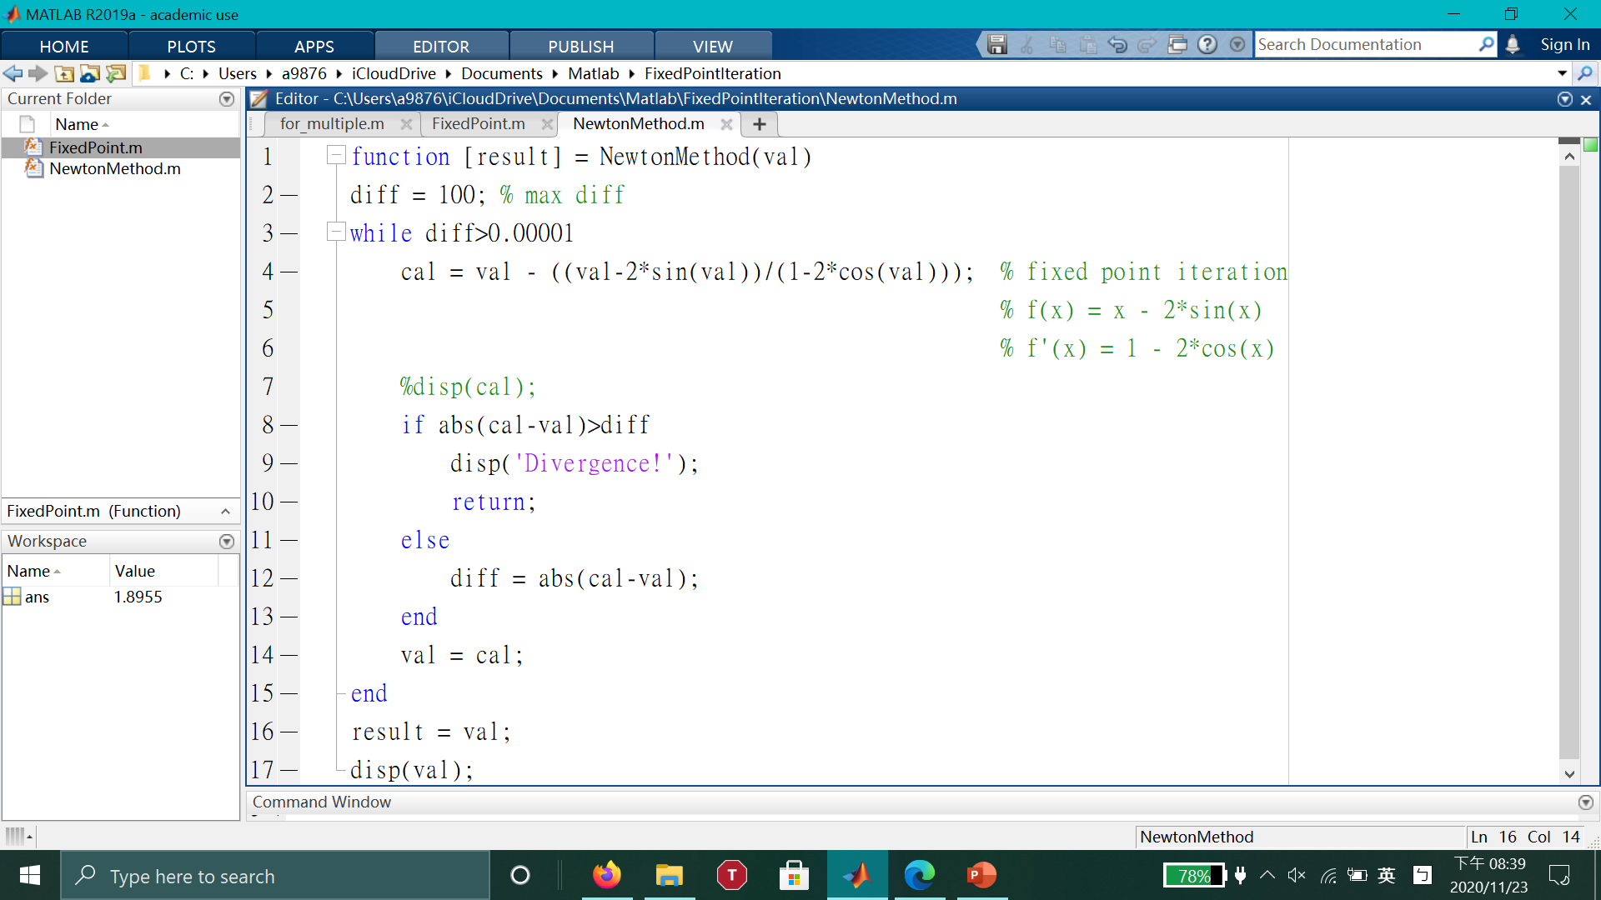

Slide 6
